Slide 1

Power and Politics in Organizational Context Focuses on how power and political behavior operate within organizations. Lecture 4A Sanjeeva Perera - Senior Academic Fellow (SLIIT)

Slide 2

Module : Professional Skills
Academic Year : 2nd Year
Lesson : Power and Politics in Organizational Context
Contributing Disciplines: Theories and Concepts from Sociology, Psychology, and Political Science

Slide 3
Lesson LOs
Identify sources of power
Explain organizational politics
Analyze political strategies for attaining power

Slide 4

Power

Slide 5
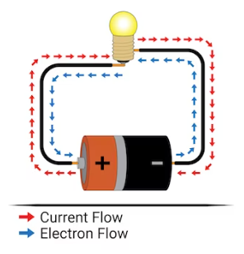
Power
What is Power ? (Physics)
Electric Power
Power is the rate at which work is done or energy is transferred. It is measured in watts (W) .

Slide 6
Definition of Power
What is Power ? (Sociology and Political Science)
Max Weber (pioneering sociologist)
The probability that one actor within a social relationship will be in a position to carry out his own will despite resistance.

Slide 7
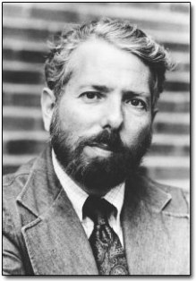
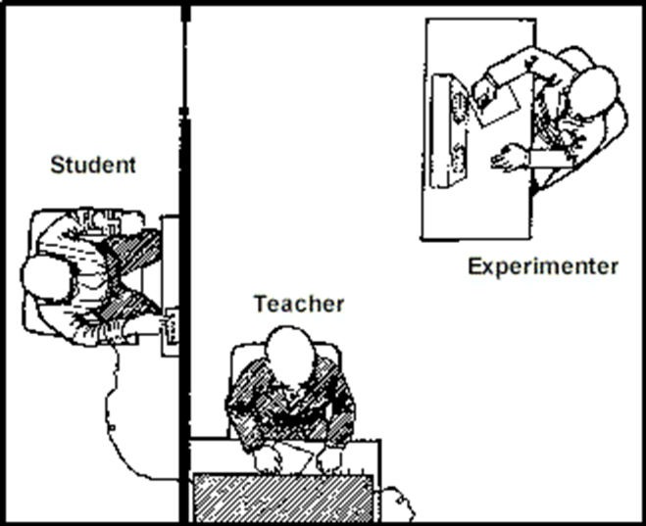
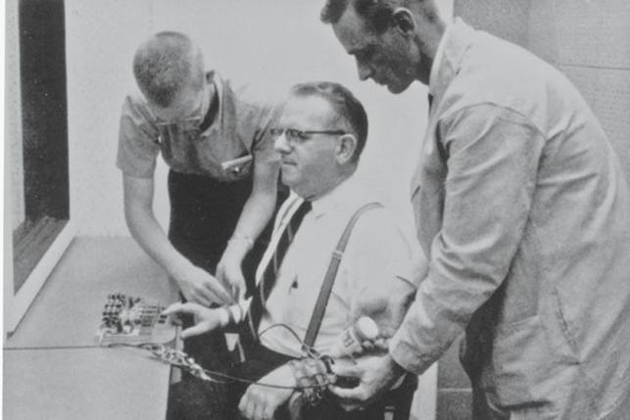
Power, formal authority, and obedience
The Milgram experiments
Conducted by American social psychologist Stanley Milgram, the controversial and groundbreaking experiments on obedience to authority took place at Yale University in the early 1960s
Video : Milgram's Obedience to Authority Experiment

Slide 8
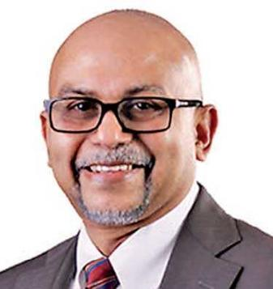
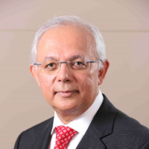

Concept of Power
Power - the ability to influence another person
Dian Gomes, Chairman at Hela Clothing, ex-Managing Director of MAS Holdings
Authority - the right to influence another person
Mahesh Amalean, Co- Funder & Chairman of MAS Holdings
Notes:
2

Slide 9
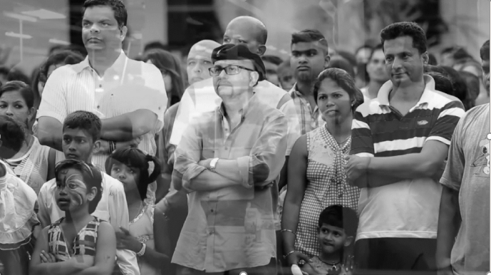
Dian Gomes: A Heartfelt Farewell Tribute from MAS Intimates
Notes:
2

Slide 10
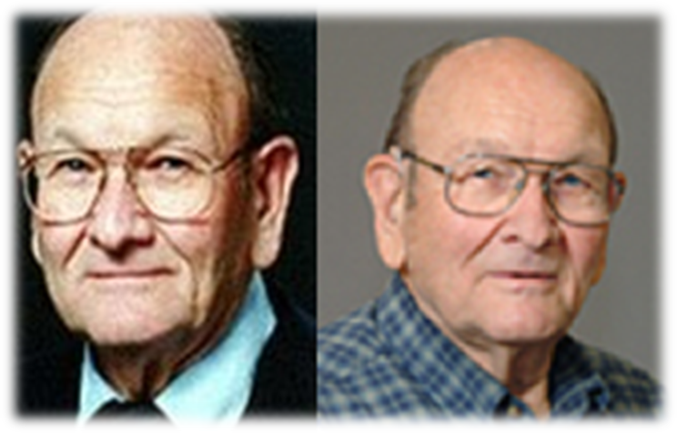
The five forms of power in the workplace
In a notable study of power conducted by American social psychologists John R. P. French and Bertram Raven in 1959, power was divided into five separate and distinct forms.
They developed the concept of the five bases of power through a combination of theoretical analysis and empirical research

Slide 11
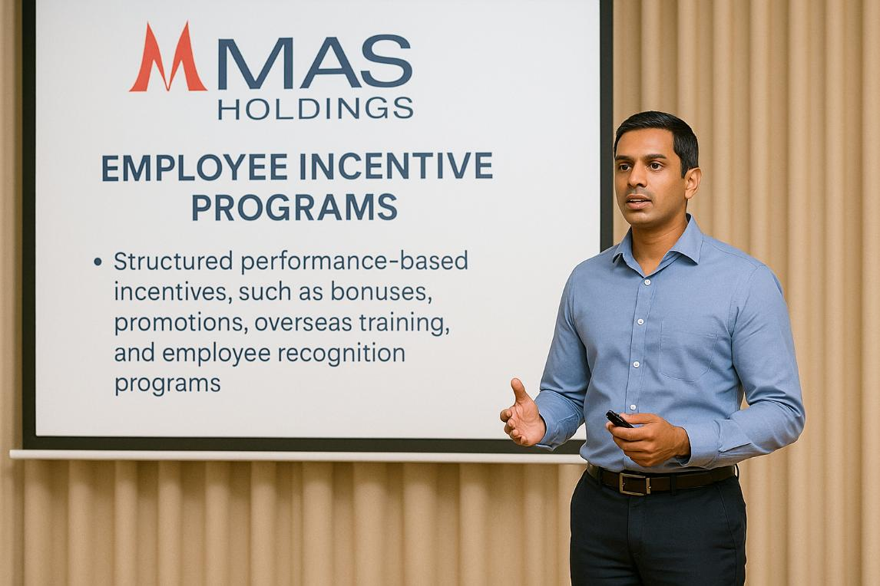
Reward Power agent’s ability to control the rewards that the target wants

Slide 12

Legitimate Power agent and target agree that agent has influential rights, based on position and mutual agreement
The Factory Manager (agent) may assign shift schedules, approve leave, or enforce safety protocols. The employees (targets) follow these directions because they acknowledge the manager’s right to make such decisions based on his/her position within the company.

Slide 13

Coercive Power agent’s ability to cause an unpleasant experience for a target
When a worker consistently fails to meet daily production quotas or violates safety rules, the supervisor (agent) warns the worker of possible disciplinary action

Slide 14

Expert Power agent has knowledge target needs
Textile Engineer Advising on Fabric Optimization. MAS Holdings employs textile engineers and R&D specialists who have deep expertise in fabric technology, sustainability, and production efficiency.

Slide 15

Referent (Charismatic) Power based on interpersonal attraction- timing matters
During a critical production delay or market challenge, a young, energetic team leader at MAS Holdings rallies her team not through formal authority, but through her personal charm, trustworthiness, and passion.

Slide 16

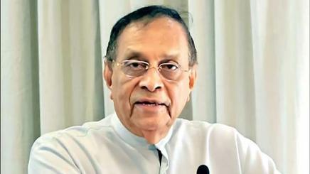
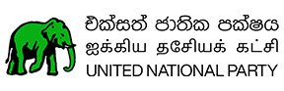
Question 1

Slide 17
Question 1
During his tenure from 1997-1999 as Mayor of Colombo Municipal Council, Karu Jayasuriya introduced a new method of garbage collection that significantly improved waste management in the city. Which type of power did Karu Jayasuriya most likely exercise through this initiative?
Legitimate Power – His power was based on his official position as Mayor of Colombo.
Expert Power – His power was based on his knowledge and innovative approach to urban management and waste disposal.
Reward Power – His power was based on the incentives provided to municipal workers for effective garbage collection.
Referent Power – His power was based on the respect and admiration he gained from residents for improving the city's cleanliness.
Answer: B

Slide 18

Question 2
Upkesha Swarnamali, a well-known Paba teledrama actress in 2008, leveraged her popularity when she contested in the 2010 General Election. Which type of power did Upkesha Swarnamali primarily utilize in her political campaign?
Legitimate Power – Her power was derived from an official position she held before the election.
Reward Power – Her power was based on her ability to offer incentives or benefits to her supporters.
Coercive Power – Her power was based on the ability to impose penalties or sanctions.
Charismatic Power – Her power was based on her personal charm, appeal, and influence over the public.
Answer: D

Slide 19


General Election 2010 - Preferential Votes Gampaha District -UNP
Upeksha Swarnamali - Teledrama Actress
Charismatic Power
Karu Jayasuriya - Veteran Politician
Expert Power
Preferential Votes – 81,350
Preferential Votes – 60,310

Slide 20
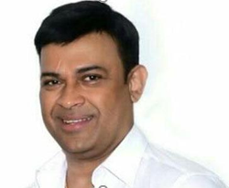
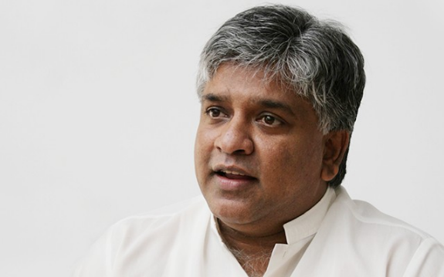
General Election 2015 - Preferential Votes Gampaha District -UNP
Ranjan Ramanayake –Veteran Actor
Charismatic Power
Arjuna Ranatunga – Ex Cricket Captain
Charismatic Power
Preferential Votes – 216,463
Preferential Votes – 165,890
Upeksha Swarnamali chose not to contest in the 2015 Election
Charismatic Power – The Importance of Timing
(Upeksha's Struggle to Sustain Influence)

Slide 21
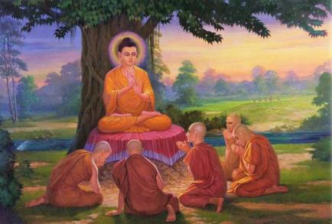
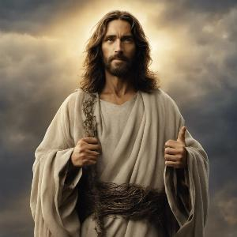
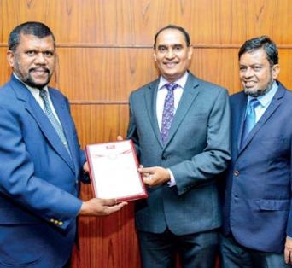
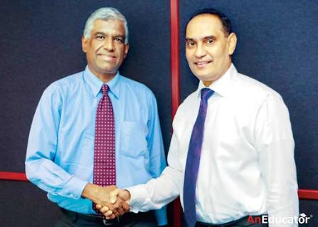
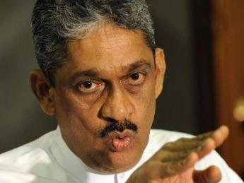
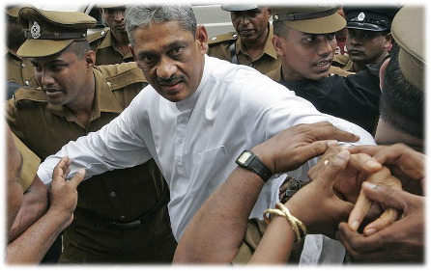
Consequences of Power
Sources of Power
Consequences of Power
Expert
Power
Commitment
Followers for over two thousand years
Referent
Power
Legitimate Power
Compliance
Reward Power
Resistance
Coercive
Power

Slide 22
Political Behavior in Organizations
Politics in organizations is simply a fact of life
Political Behavior - Actions not officially sanctioned (authorized) by an organization that are taken to influence others in order to meet one’s personal goals
Stephen P. Robbins
Notes:
14

Slide 23
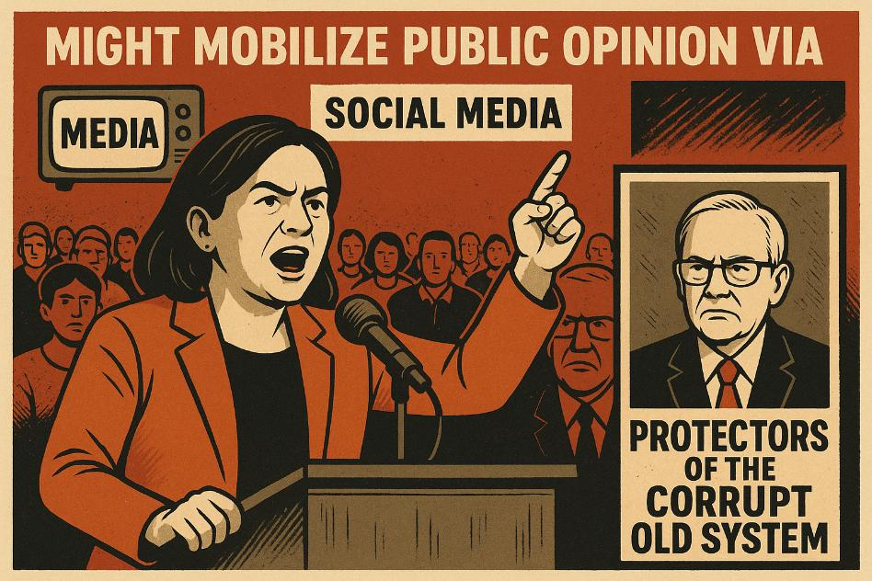
Political Strategies for Attaining Power in Organization
Neutralizing potential opposition
Government might mobilize public opinion via Government-aligned media, town halls, or social media, framing elite critics as “protectors of the corrupt old system.”
Notes:
14

Slide 24
Political Strategies for Attaining Power in Organization
Committing the uncommitted
Corporate Example – MAS Holdings
Scenario: MAS wanted to improve engagement among factory floor employees who were not emotionally invested in company goals.
To commit the uncommitted:
MAS launched a "Voice of the Employee" program, encouraging workers to suggest improvements.
Recognized suggestions were implemented publicly, and employees were rewarded.
This gave previously disengaged workers a sense of ownership, increasing commitment and performance.
Notes:
14

Slide 25
Political Strategies for Attaining Power in Organization
Forming a winning coalition
Example: President Maithripala Sirisena’s 2015 Victory
In the 2015 Presidential Election, Maithripala Sirisena, a former SLFP minister, broke away from the Rajapaksa regime and ran as a common opposition candidate.
To form a winning coalition, he United multiple opposition parties, including the UNP, JHU, TNA, and civil society organizations.
Appealed to minority communities (Tamils and Muslims) and moderate Sinhalese voters.
Positioned the coalition as a movement for democratic change, good governance, and anti-corruption.
This broad alliance, despite ideological differences, had a common goal: defeating Mahinda Rajapaksa. Together, they secured a surprise win a classic example of forming a winning coalition to achieve a strategic objective.
Notes:
14

Slide 26
Questions ?
Notes:
14

